Slide 1
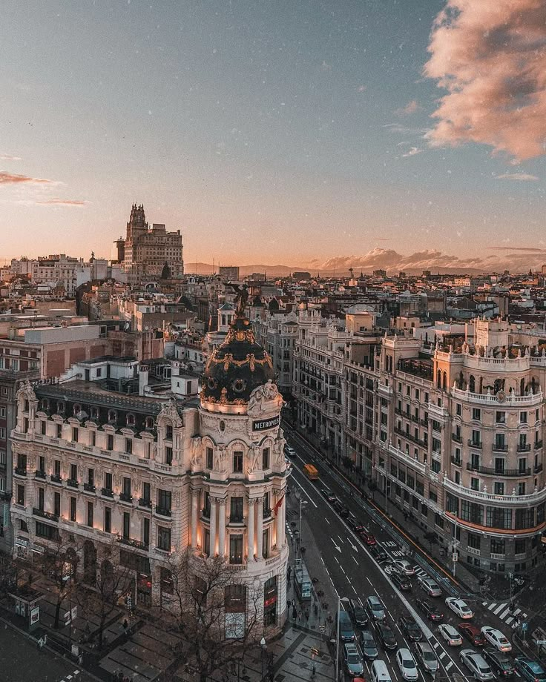
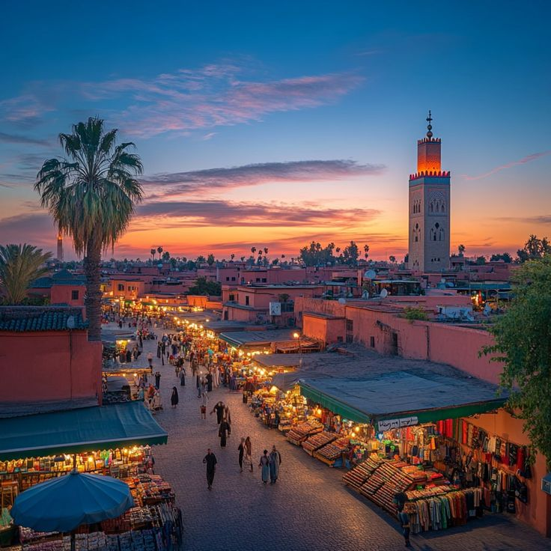
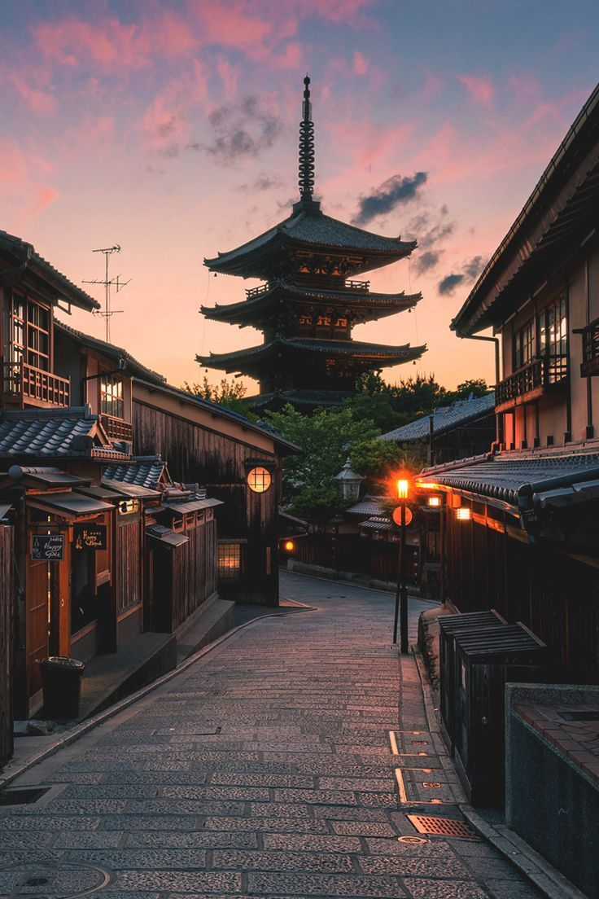
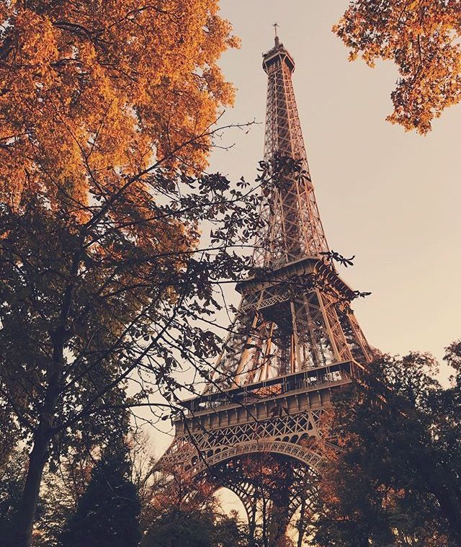
THE BEST CITY IN THE WORLD

Slide 2
THE BEST CITY IN THE WORLD
Madrid
Fzejuezj ezcgyebhg ufgtzl lrjzfsbj nldfly iufj

Slide 3
THE BEST CITY IN THE WORLD
Marrakeshe
Fzejuezj ezcgyebhg ufgtzl lrjzfsbj nldfly iufj

Slide 4
THE BEST CITY IN THE WORLD
Tokyo
Fzejuezj ezcgyebhg ufgtzl lrjzfsbj nldfly iufj

Slide 5
THE BEST CITY IN THE WORLD
Paris
Fzejuezj ezcgyebhg ufgtzl lrjzfsbj nldfly iufj

Slide 6
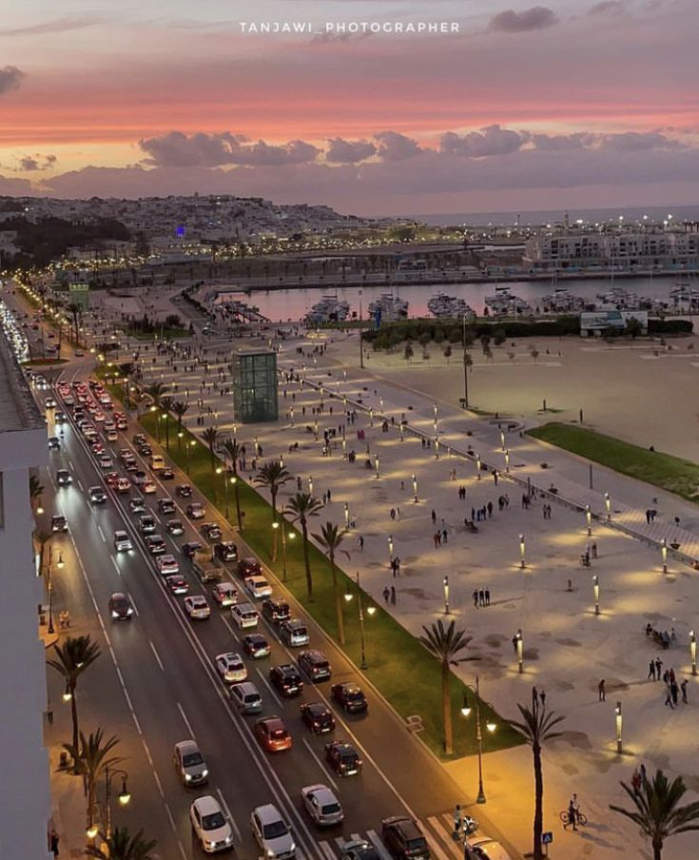
THE BEST CITY IN THE WORLD is Tanger

Slide 7
THE BEST CITY IN THE WORLD is Tanger
Madrid
Tanger
Marakeshe
Tokyo
Paris

